Slide 1
CSE 185 Introduction to Computer Vision
Edges

Slide 2
Edges
Edges
Scale space
Reading: Chapter 4.2

Slide 3
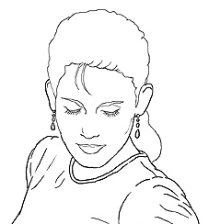
Edge detection
Goal: Identify sudden changes (discontinuities) in an image
Intuitively, most semantic and shape information from the image can be encoded in the edges
More compact than pixels
Ideal: artist’s line drawing (but artist is also using object-level knowledge)

Slide 4
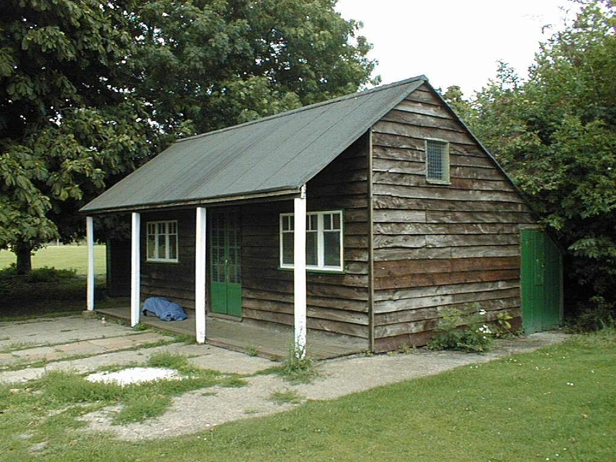
Why do we care about edges?
Extract information, recognize objects
Recover geometry and viewpoint
Measure distance
Compute area
See also single-view 3D
Vertical vanishing
point
(at infinity)
Vanishing
line
Vanishing
point
Vanishing
point
[Criminisi et al. ICCV 99]

Slide 5
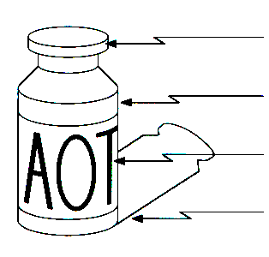
Origin of Edges
surface normal discontinuity
depth discontinuity
surface color discontinuity
illumination discontinuity
Edges are caused by a variety of factors

Slide 6
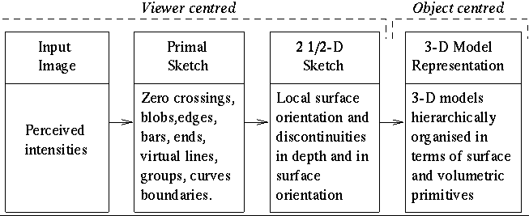
Marr’s theory

Slide 7
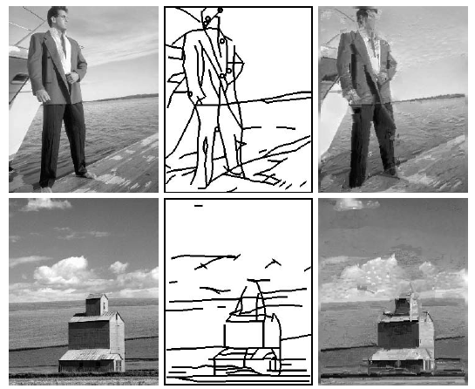
Example

Slide 8
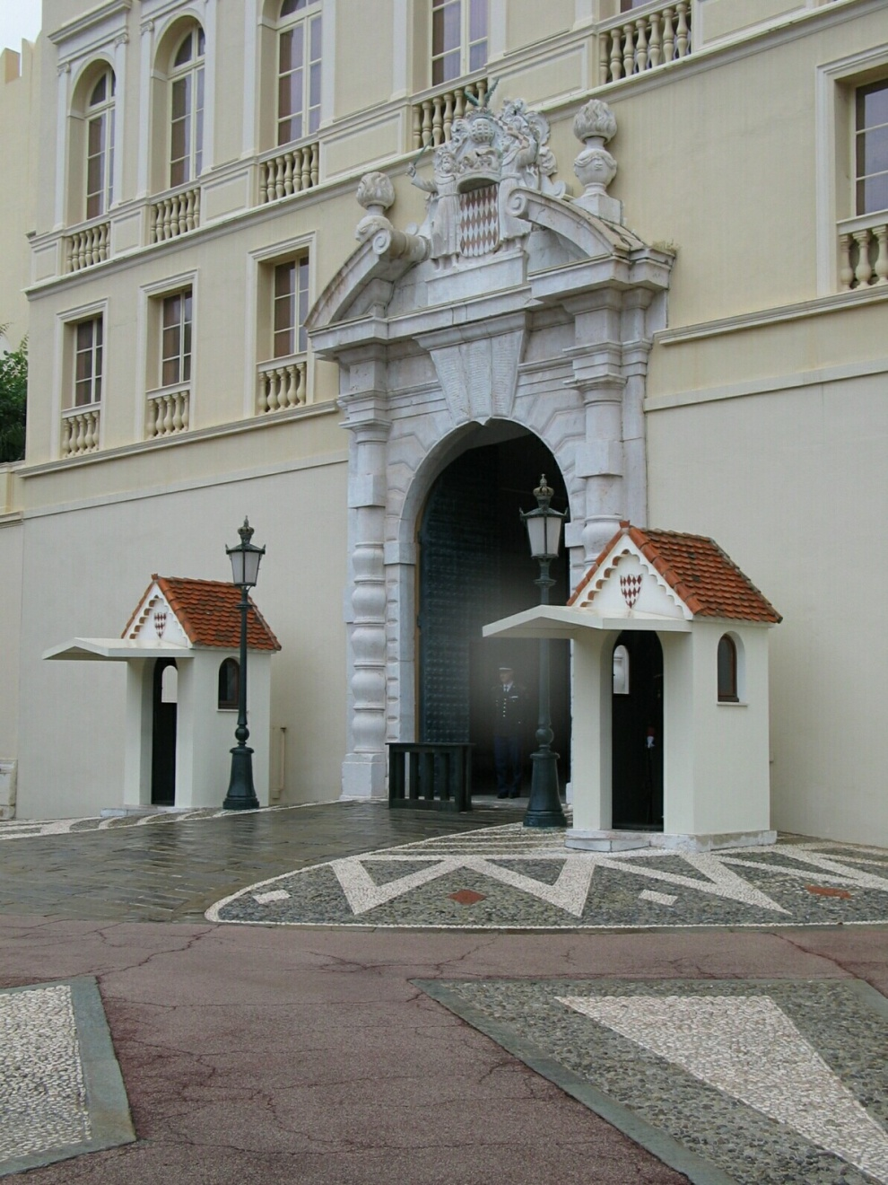
Closeup of edges
Source: D. Hoiem

Slide 9
Closeup of edges

Slide 10
Closeup of edges

Slide 11
Closeup of edges

Slide 12

Characterizing edges
An edge is a place of rapid change in the image intensity function
intensity function (along horizontal scanline)
image
first derivative
edges correspond to extrema of derivative

Slide 13
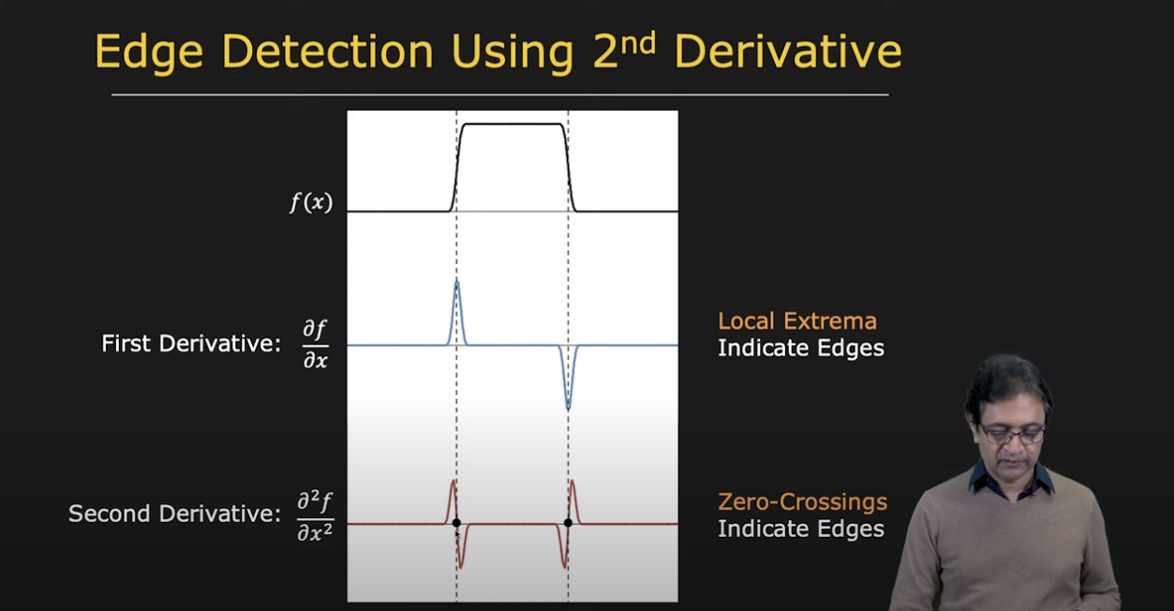
1st and 2nd derivative
See https://www.youtube.com/watch?v=uNP6ZwQ3r6A

Slide 14
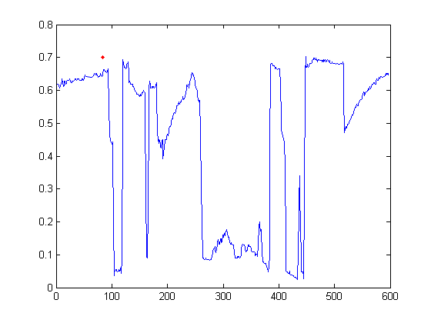

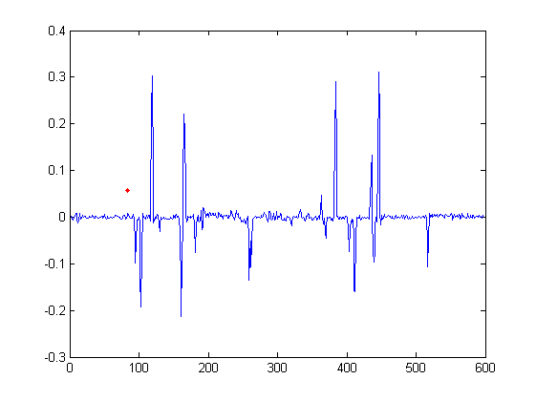
Intensity profile

Slide 15
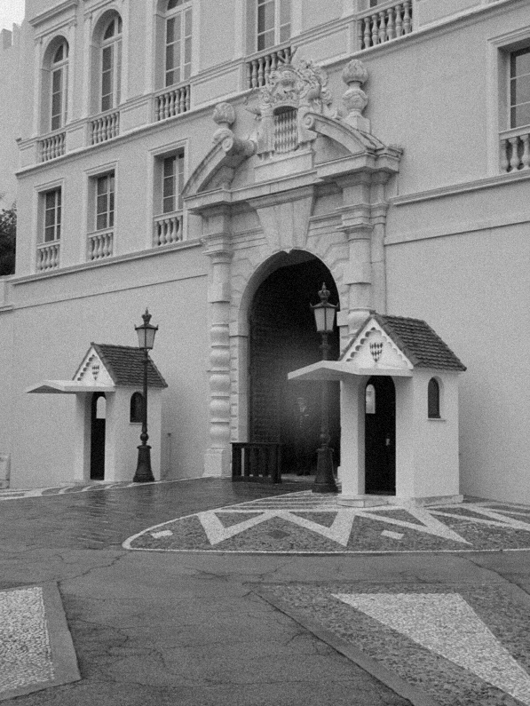
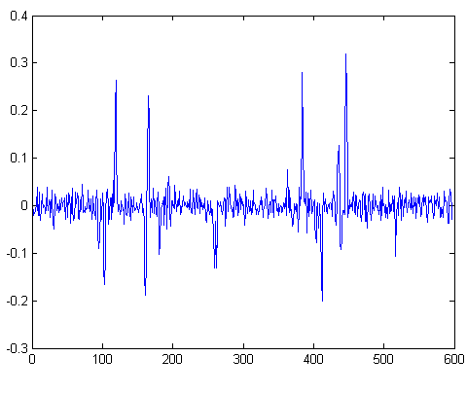
With a little Gaussian noise
Gradient

Slide 16
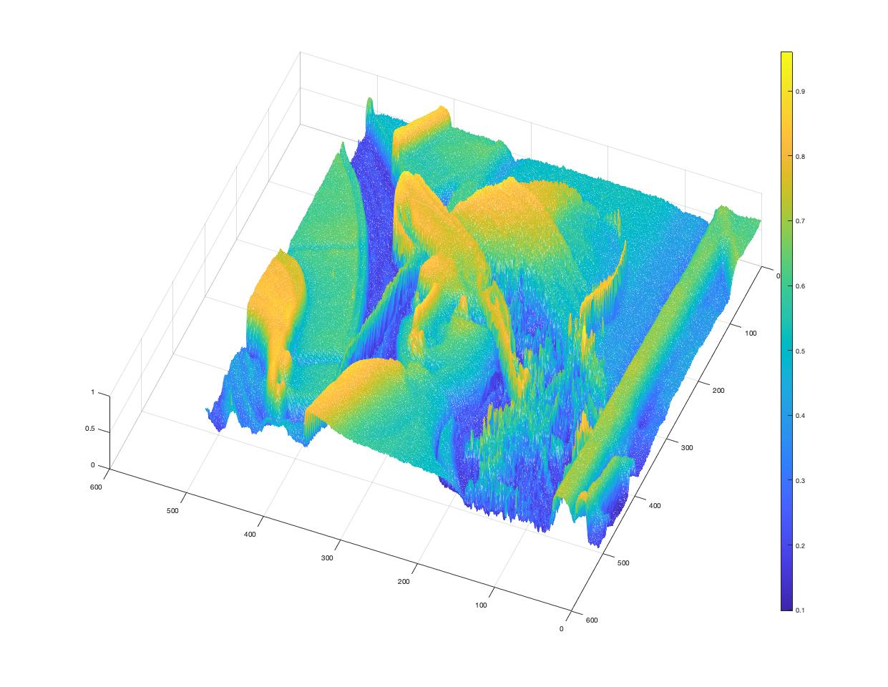
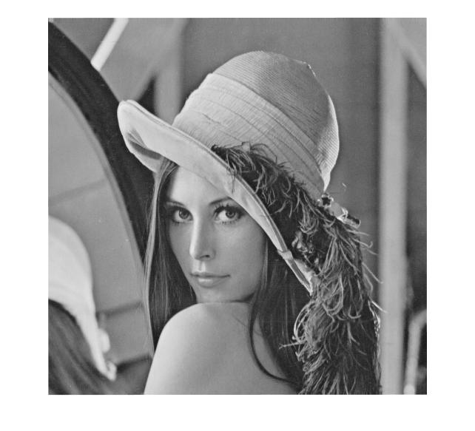
Consider pixel value as height
I=imread('lena_gray.png');
[x,y]=size(I);
X=1:x;
Y=1:y;
[xx,yy]=meshgrid(Y,X);
i=im2double(I);
figure;mesh(xx,yy,i);
colorbar
figure;imshow(i)
Plot intensity value as needle map,
i.e., (x, y, z), where x, y are image coordinate
and z is the pixel value (color bar indicates the
intensity value from low to high)

Slide 17
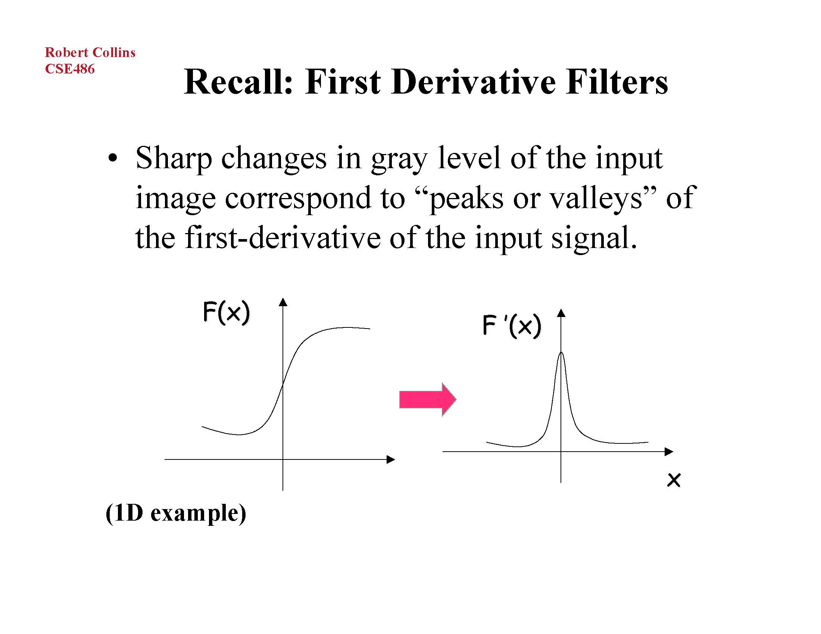
First-order derivative filter

Slide 18
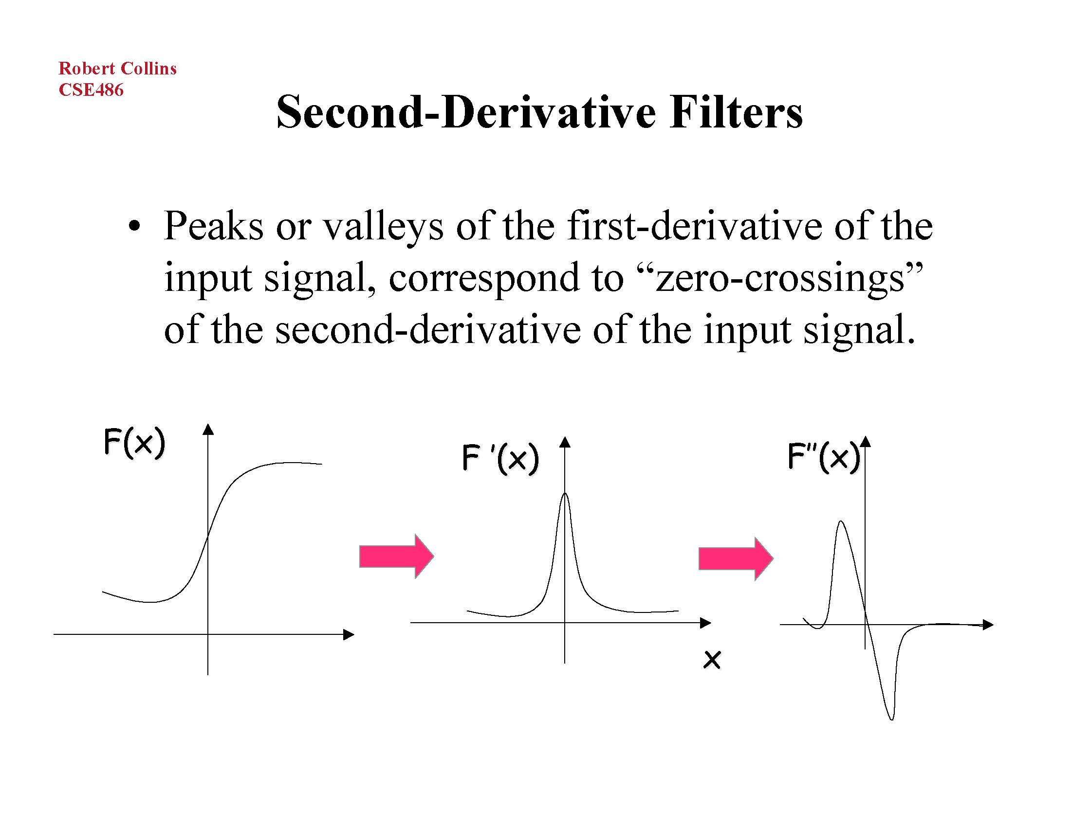
Second-order derivative filter

Slide 19
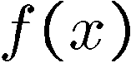
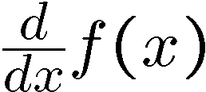
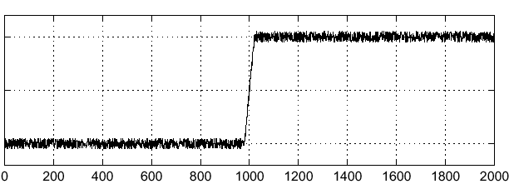
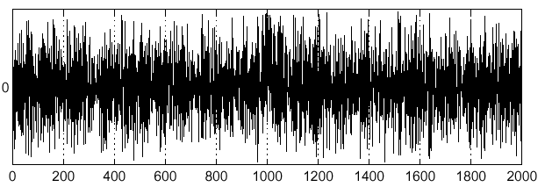
Effects of noise
Consider a single row or column of the image
Plotting intensity as a function of position gives a signal
Where is the edge?
Notes:
How to fix?

Slide 20
Effects of noise
Difference filters respond strongly to noise
Image noise results in pixels that look very different from their neighbors
Generally, the larger the noise the stronger the response
What can we do about it?

Slide 21
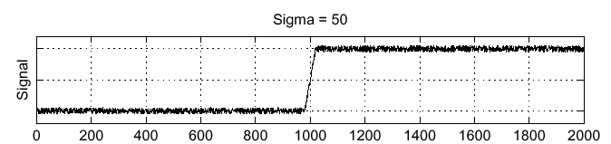
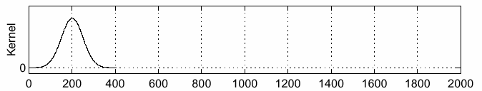
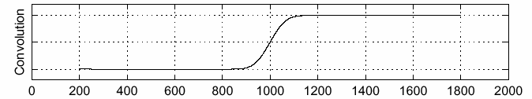
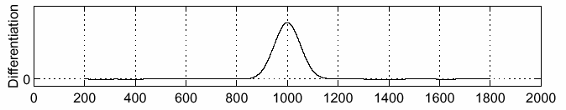
Solution: smooth first
f
g
f * g
To find edges, look for peaks in

Slide 22
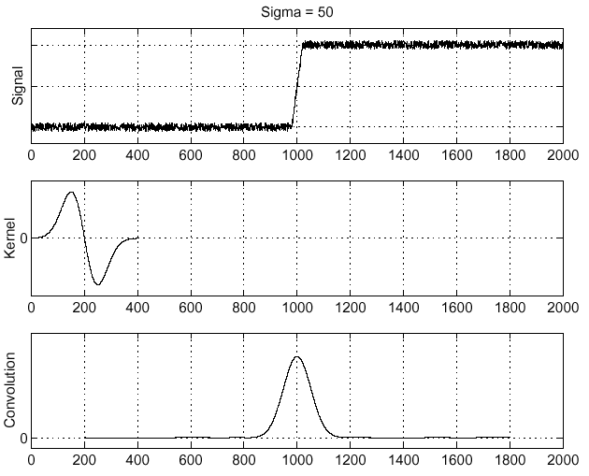
Derivative theorem of convolution
Recall associative property: a * (b * c) = (a * b) * c
Differentiation is convolution, and convolution is associative:
This saves us one operation:
f

Slide 23

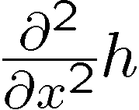
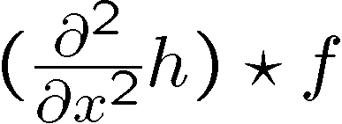
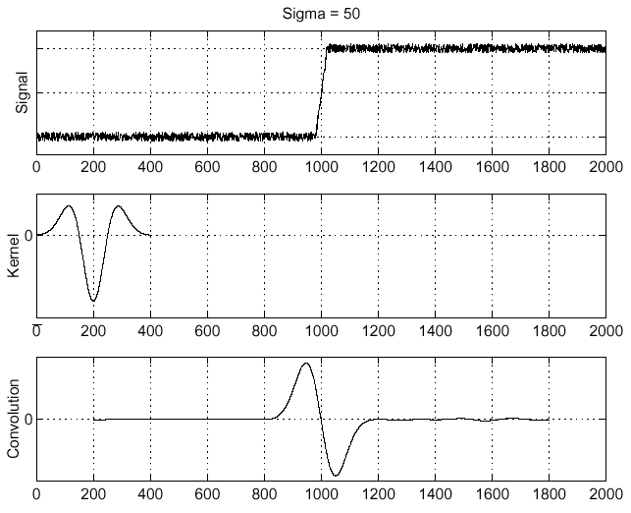
Laplacian of Gaussian (LoG)
Laplacian of Gaussian
Laplacian of Gaussian operator
Where is the edge?
Zero-crossings of bottom graph !

Slide 24
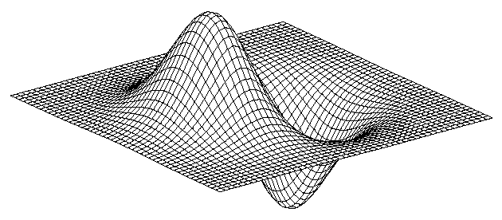
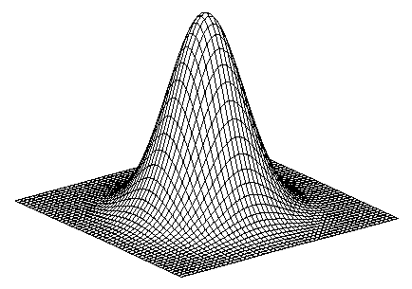
Derivative of Gaussian filter
* [1 -1] =
Notes:
Is this filter separable?

Slide 25
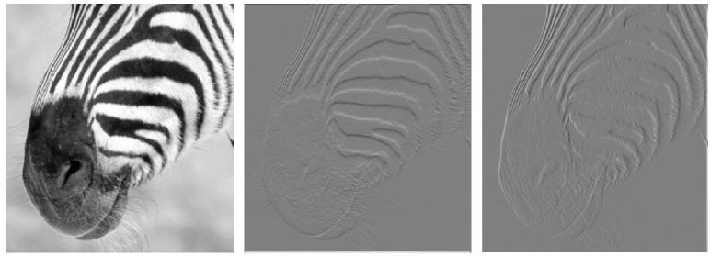
Finite differences
Partial derivative in y axis,
respond strongly to
horizontal edges
Partial derivative in x axis,
respond strongly to
vertical edges
Notes:
Now the figure on the right is signed; darker is negative, lighter is positive, and mid grey is zero.
I always ask 1) which derivative (y or x) is this? 2) Have I got the sign of the kernel right? (i.e.
is it d/dx or -d/dx).

Slide 26
Differentiation and convolution
Recall
Now this is linear and shift invariant, so must be the result of a convolution
We could approximate this as
(which is obviously a convolution; it’s not a very good way to do things, as we shall see)
Notes:
I tend not to prove “Now this is linear and shift invariant, so must be the result of a convolution” but
leave it for people to look up in the chapter.

Slide 27
Discrete edge operators
How can we differentiate a discrete image?
Finite difference approximations:
𝛆
Convolution masks :
-1
1
1
1
-1
1
-1
-1
See https://en.wikipedia.org/wiki/Edge_detection

Slide 28

Discrete edge operators
Second order partial derivatives:
Laplacian :
$\frac{∂I}{∂x}≈\frac{1}{ε}$ ($I_{i+1,j}−I_{i,j})$
$\frac{∂^{2}I}{∂x^{2}}≈\frac{1}{ε} (\frac{1}{ε}$($I_{i+1,j}−I_{i,j})−\frac{1}{ε}(I_{i,j}$- $I_{i−1,j}))$
Convolution masks :
0 | 1 | 0
1 | -4 | 1
0 | 1 | 0
1 | 4 | 1
4 | -20 | 4
1 | 4 | 1
or
(more accurate)

Slide 29
Spatial filter
Approximation of image gradient
Z₁ | Z₂ | Z₃
Z₄ | Z₅ | Z₆
Z₇ | Z₈ | Z₉
filter weight
different ways to compute gradient magnitude

Slide 30
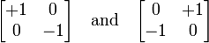
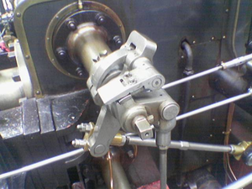
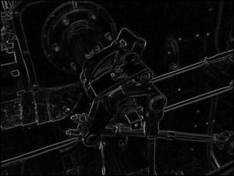
Roberts operator
One of the earliest edge detection algorithm by Lawrence Roberts
Convolve image with to get G_{x} and G_{y}

Slide 31
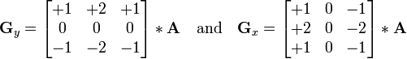
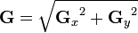
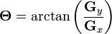
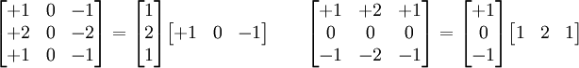
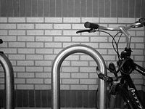
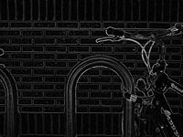
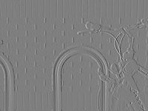
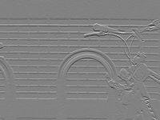
Sobel operator
One of the earliest edge detection algorithm by Irwine Sobel
G_{x}+G_{y}
G_{x}
G_{y}

Slide 32

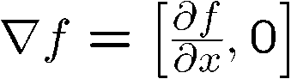
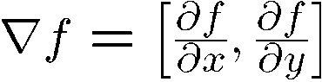
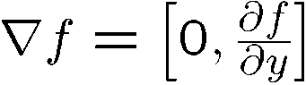
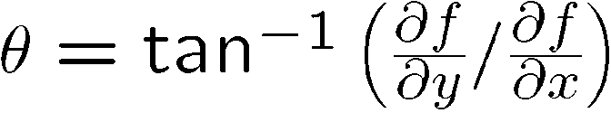
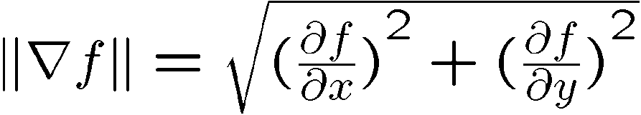

Image gradient
Gradient equation $f(x,y)$
Represents direction of most rapid change in intensity
Gradient direction:
The edge strength is given by the gradient magnitude

Slide 33
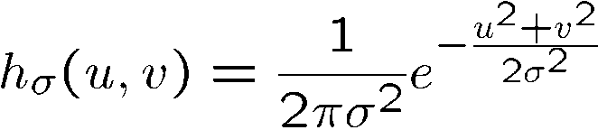
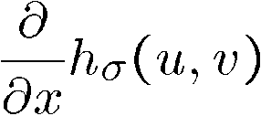
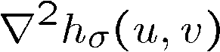
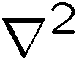


2D Gaussian edge operators
Gaussian
Derivative of Gaussian (DoG)
Laplacian of Gaussian (LoG)
Mexican Hat (Sombrero)
is the Laplacian operator:
Marr-Hildreth algorithm

Slide 34

Difference of Gaussians (DoG)
Laplacian of Gaussian can be approximated by the
difference between two different Gaussians

Slide 35



Smoothing and localization
1 pixel
3 pixels
7 pixels
Smoothed derivative removes noise, but blurs edge. Also finds edges at different “scales”.

Slide 36




threshold
sigma=4
scale
contrast=1
LOG zero crossings
contrast=4
sigma=2

Slide 37


We still have unfortunate behavior
at corners and trihedral areas
Notes:
This is the usual story; if you find edges as a level crossing of a function, then trihedral vertices
are going to cause trouble. Also, notice the bulges at the corners.

Slide 38

Implementation issues
The gradient magnitude is large along a thick “trail” or “ridge,” so how do we identify the actual edge points?
How do we link the edge points to form curves?
Notes:
Figures show gradient magnitude of zebra at two different scales

Slide 39
Designing an edge detector
Criteria for a good edge detector:
Good detection
the optimal detector should find all real edges, ignoring noise or other artifacts
Good localization
the edges detected must be as close as possible to the true edges
the detector must return one point only for each true edge point
Cues of edge detection
Differences in color, intensity, or texture across the boundary
Continuity and closure
High-level knowledge

Slide 40
Canny edge detector
Probably the most widely used edge detector in computer vision
Theoretical model: step-edges corrupted by additive Gaussian noise
John Canny has shown that the first derivative of the Gaussian closely approximates the operator that optimizes the product of signal-to-noise ratio and localization
J. Canny, A Computational Approach To Edge Detection, IEEE Trans. Pattern Analysis and Machine Intelligence, 8:679-714, 1986.
http://www.mathworks.com/discovery/edge-detection.html

Slide 41

Example
original image (Lena)

Slide 42


Derivative of Gaussian filter
x-direction
y-direction

Slide 43



Compute gradients
X-Derivative of Gaussian
Y-Derivative of Gaussian
Gradient Magnitude

Slide 44

Get orientation at each pixel
Threshold at minimum level
Get orientation
theta = atan2(gy, gx)

Slide 45



Non-maximum suppression for each orientation
At q, we have a maximum if the value is larger than those at both p and at r.
Interpolate to get these values.
Select the single maximum point across the width of an edge
A variant is to use Laplacian zero crossing along the gradient direction.

Slide 46
Edge linking
Assume the marked point is an edge point. Then we construct the tangent to the edge curve (which is normal to the gradient at that point) and use this to predict the next points (here either r or s).

Slide 47



Sidebar: Bilinear Interpolation
http://en.wikipedia.org/wiki/Bilinear_interpolation

Slide 48



Sidebar: Interpolation options
imx2 = imresize(im, 2, interpolation_type)
‘nearest’
Copy value from nearest known
Very fast but creates blocky edges
‘bilinear’
Weighted average from four nearest known pixels
Fast and reasonable results
‘bicubic’ (default)
Non-linear smoothing over larger area (4x4)
Slower, visually appealing, may create negative pixel values

Slide 49
Before non-max suppression

Slide 50

After non-max suppression

Slide 51
Before non-max suppression

Slide 52

After non-max suppression

Slide 53

Hysteresis thresholding
Threshold at low/high levels to get weak/strong edge pixels
Use connected components, starting from strong edge pixels

Slide 54
Hysteresis thresholding
Check that maximum value of gradient value is sufficiently large
drop-outs? use hysteresis
use a high threshold to start edge curves and a low threshold to continue them.
Source: S. Seitz

Slide 55

Final Canny edges

Slide 56
Canny edge detector
Filter image with x, y derivatives of Gaussian
Find magnitude and orientation of gradient
Non-maximum suppression:
Thin multi-pixel wide “ridges” down to single pixel width
Thresholding and linking (hysteresis):
Define two thresholds: low and high
Use the high threshold to start edge curves and the low threshold to continue them
MATLAB: edge(image, ‘canny’)

Slide 57





Effect of σ (Gaussian kernel size)
original
Canny with
Canny with
The choice of σ depends on desired behavior
large σ detects large scale edges
small σ detects fine features

Slide 58






Where do humans see boundaries?
image
human segmentation
gradient magnitude
Berkeley segmentation database: http://www.eecs.berkeley.edu/Research/Projects/CS/vision/grouping/segbench/

Slide 59

Building visual dictionaries
Sample patches from a database
E.g., 128 dimensional SIFT vectors
Cluster the patches
Cluster centers are the dictionary
Assign a codeword (number) to each new patch, according to the nearest cluster

Slide 60

pB boundary detector
Martin, Fowlkes, Malik 2004: Learning to Detect Natural Boundaries…
http://www.eecs.berkeley.edu/Research/Projects/CS/vision/grouping/papers/mfm-pami-boundary.pdf

Slide 61

Brightness
Color
Texture
Combined
Human

Slide 62



Pb (0.88)
Human (0.95)

Slide 63
State of edge detection
Local edge detection works well
But many false positives from illumination and texture edges
Some methods to take into account longer contours, but could probably do better
Poor use of object and high-level information

Slide 64


Sketching
Learn from artist’s strokes so that edges are more likely in certain parts of the face.
Berger et al. SIGGRAPH 2013

